Slide 1
Smart Watch Progress Report 2
Derek Tan, Julian Nguyen, Eddie Ryan

Slide 2
Revised Project
Original | Revised
DA14683 Too small for Advanced Circuits Basic accelerometer Wake up gesture Digital screen Microphone + speaker Contact pin charging | MSP430F1611 Familiar, still has integrated Bluetooth Gyroscope + accelerometer 6 DOF motion tracking LED array display Nope Wireless inductive charging

Slide 3
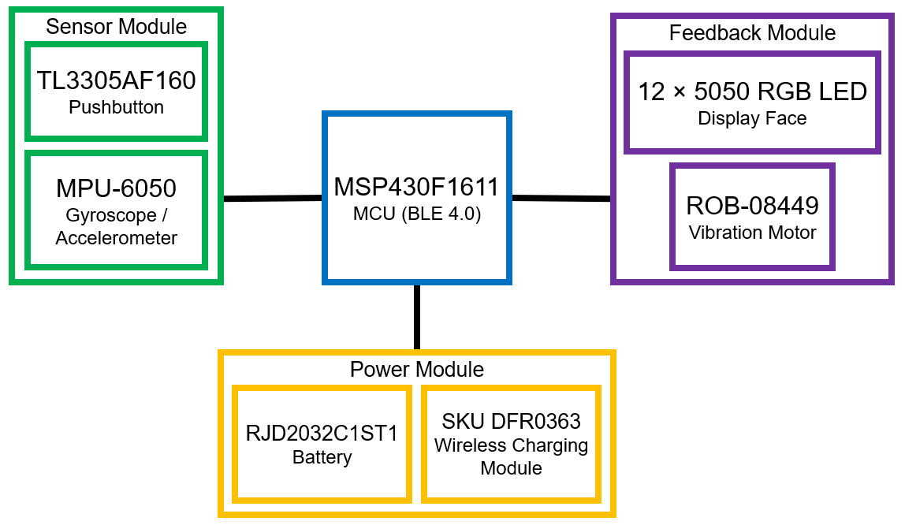
Revised Schematic
Communication
Bluetooth interface
Sensors
Pushbutton control (modes)
Gyroscope/accelerometer
(motion tracking, gesture controls)
Feedback
LED array display (timekeeping)
Vibration
Power

Slide 4
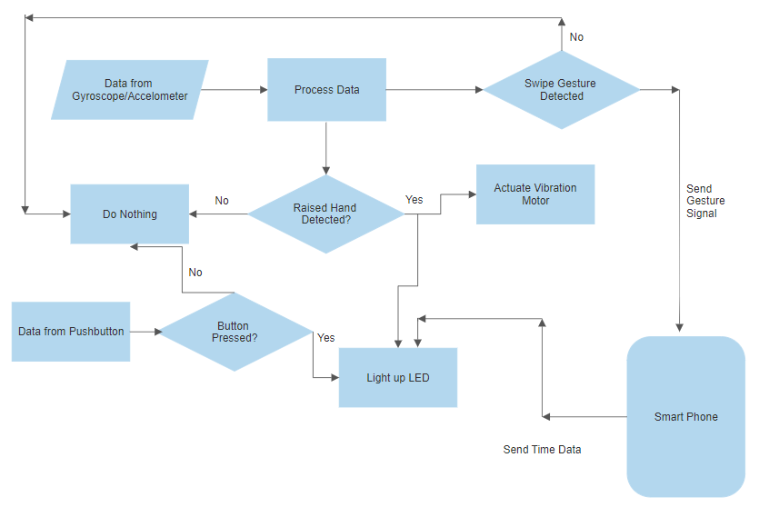
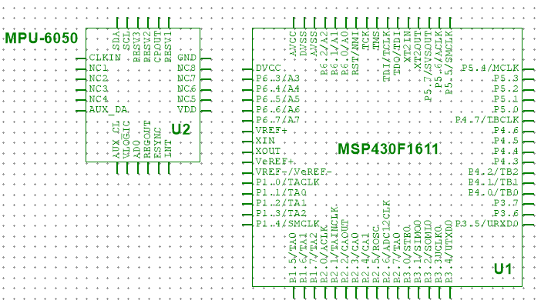
Final Proposal/Begin Schematic

